Slide 1
Process vs Program
A process is just an instance of an executing program, including the current values of the program counter, registers, and variables.
A process is an activity of some kind, it has program, input, output and state.
In contrast, a program is something that may be stored on disk, not doing anything.
For example, it is often possible to start a word processor twice or print two files at the same time if two printers are available. The fact that two processes happen to be running the same program does not matter; they are distinct processes.

Slide 2
Consider a culinary-minded computer scientist who is baking a birthday cake for his young daughter.
He has a birthday cake recipe and a kitchen well stocked with all the input: flour, eggs, sugar, extract of vanilla, and so on.
In this analogy, the recipe is the program, that is, an algorithm expressed in some suitable notation, the computer scientist is the processor (CPU), and the cake ingredients are the input data. The process is the activity consisting of our baker reading the recipe, fetching the ingredients, and baking the cake.
Now imagine that the computer scientist’s son comes running in screaming his head off, saying that he has been stung by a bee.
The computer scientist records where he was in the recipe (the state of the current process is saved), gets out a first aid book, and begins following the directions in it.
Here we see the processor being switched from one process (baking) to a higher-priority process (administering medical care), each having a different program (recipe versus first aid book).
When the bee sting has been taken care of, the computer scientist goes back to his cake, continuing at the point where he left off.

Slide 3
Multiprogramming
One of the most important aspects of operating systems is the ability of multiprogramming.
Here multiple programs can be executed simultaneously.
Multiprogrammed systems provide an environment in which the various system resources (for example, CPU, memory, and peripheral devices) are utilized effectively, but they do not provide for user interaction with the computer system.
A single user cannot, in general, keep either the CPU or the I/O devices busy at all times.
Multiprogramming increases CPU utilization by organizing jobs (code and data) so that the CPU always has one to execute.
The idea is as follows: The operating system keeps several jobs in memory simultaneously (Figure ).
The operating system picks and begins to execute one of the jobs in memory.
Eventually, the job may have to wait for some task, such as an I/O operation, to complete.
In a non-multiprogrammed system, the CPU would sit idle. But In a multiprogrammed system, the operating system simply switches to, and executes, another job.
When that job needs to wait, the CPU is switched to another job, and so on.
Eventually, the first job finishes waiting and gets the CPU back. As long as at least one job needs to execute, the CPU is never idle.

Slide 4
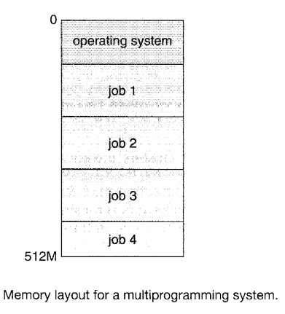

Slide 5
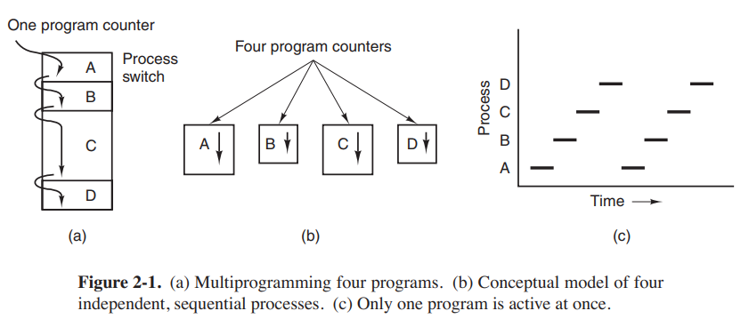
Process Model
In this model, all the runnable software on the computer, sometimes including the operating system, is organized into a number of sequential processes, or just processes for short.
The real CPU switches back and forth from process to process called multiprogramming.

Slide 6
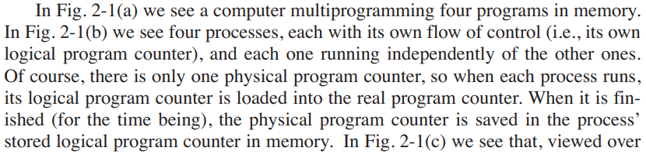

Slide 7
Process State
Using the process model, it becomes much easier to think about what is going on inside the system.
Some of the processes run programs that carry out commands typed in by a user. Other processes are part of the system and handle tasks such as carrying out requests for file services or managing the details of running a disk or a tape drive.
When a disk interrupt occurs, the system makes a decision to stop running the current process and run the disk process, which was blocked waiting for that interrupt.
Thus, instead of thinking about interrupts, we can think about user processes, disk processes, terminal processes, and so on, which block when they are waiting for something to happen.
When the disk has been read or the character typed, the process waiting for it is unblocked and is eligible to run again.

Slide 8
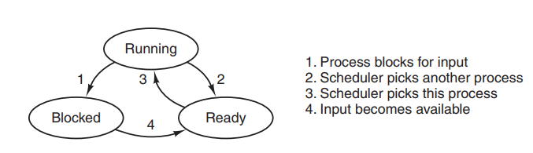
Figure: A process can be in running, blocked, or ready state. Transitions between these states are as shown
We see a state diagram showing the three states a process may be in:
1. Running (actually using the CPU at that instant).
2. Ready (runnable; temporarily stopped to let another process run).
3. Blocked (unable to run until some external event happens).

Slide 9
Transition 1 occurs when the operating system discovers that a process cannot continue right now.
Transitions 2 and 3 are caused by the process scheduler, a part of the operating system, without the process even knowing about them.
Transition 2 occurs when the scheduler decides that the running process has run long enough, and it is time to let another process have some CPU time.
Transition 3 occurs when all the other processes have had their fair share and it is time for the first process to get the CPU to run again.
Transition 4 occurs when the external event for which a process was waiting (such as the arrival of some input) happens. If no other process is running at that instant, transition 3 will be triggered and the process will start running. Otherwise it may have to wait in ready state for a little while until the CPU is available and its turn comes.

Slide 10
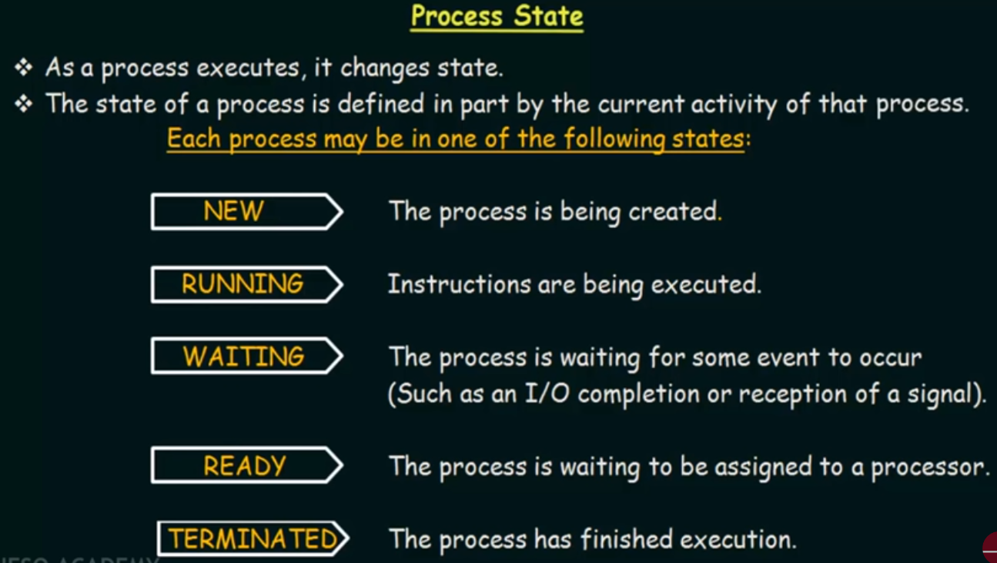

Slide 11
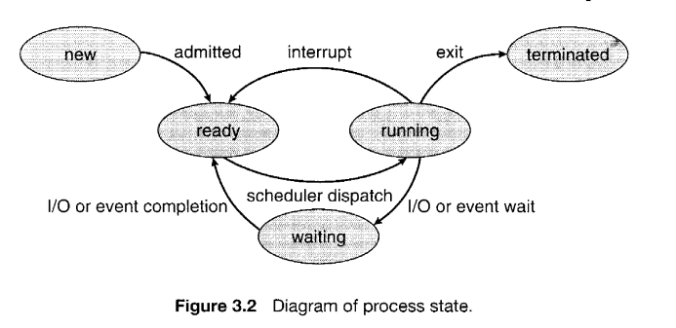
Process states (Updated)
Each process may be in one of the following states:
New: This is the initial state when a process is first started/ created.
Ready: Ready processes are waiting to have the processor allocated to them by the operating system so that they can run. Process may come into this state after start state or while running it by but interrupted by the scheduler to assign CPU to some other process.

Slide 12
3. Running: Once the process has been assigned to a processor by the OS scheduler, the process state is set to running and the processor executes its instructions.
4. Waiting: Process moves into the waiting state if it needs to wait for a resource, such as waiting for user input, or waiting for a file to become available.
5. Terminated or exit: Once the process finishes its execution or it is terminated by the OS , it is moved to the terminated state where it waits to be removed from main memory.

Slide 13
Evolution/ History of Operating system
Operating systems have been evolving through the years. In the following sections we will briefly look at a few of the highlights.
The First Generation (1945–55): Vacuum Tubes
In these early days, a single group of people (usually engineers) designed, built, programmed, operated, and maintained each machine. All programming was done in absolute machine language, or even worse yet, by wiring up electrical circuits by connecting thousands of cables to plugboards to control the machine’s basic functions. Programming languages were unknown (even assembly language was unknown). Operating systems were unheard of. Virtually all the problems were simple straightforward mathematical and numerical calculations, such as grinding out tables of sines, cosines, and logarithms, or computing artillery trajectories. Professor John Atanasoff and his graduate student Clifford Berry built what is now reg arded as the first functioning digital computer at Iowa State University. It used 300 vacuum tubes. At roughly the same time, Konrad Zuse in Berlin built the Z3 computer out of electromechanical relays. In 1944, the Colossus was built and programmed by a group of scientists (including Alan Turing) at Bletchley Park, England, the Mark I was built by Howard Aiken at Harvard, and the ENIAC was built by William Mauchley and his graduate student J. Presper Eckert at the University of Pennsylvania. Some were binary, some used vacuum tubes, some were programmable, but all were very primitive and took seconds to perform even the simplest calculation.

Slide 14
2. The Second Generation (1955–65): Transistors and Batch Systems
The introduction of the transistor in the mid-1950s changed the picture radically. Computers became reliable enough that they could be manufactured and sold to paying customers with the expectation that they would continue to function long enough to get some useful work done. For the first time, there was a clear separation between designers, builders, operators, programmers, and maintenance personnel.
To run a job (i.e., a program or set of programs), a programmer would first write the program on paper (in FORTRAN or assembler), then punch it on cards.
Given the high cost of the equipment, it is not surprising that people quickly looked for ways to reduce the wasted time. The solution generally adopted was the batch system. The idea behind it was to collect a tray full of jobs in the input room and then read them onto a magnetic tape using a small (relatively) inexpensive computer, such as the IBM 1401, which was quite good at reading cards, copying tapes, and printing output, but not at all good at numerical calculations.

Slide 15
3. The Third Generation (1965–1980): ICs and Multiprogramming
The period of third generation was from 1965-1980. the computers of third generation used integrated circuits (ICs) in place of transistors. A single IC has many transistors, resistors, and capacitors along with the associated circuitry. This development made computers smaller in size, reliable, and efficient. In this generation remote processing, time-sharing, multiprogramming operating system was used. High level languages (FORTRAN – II TO IV , COBOL, PASCAL PL/1, BASIC, ALGOL-68, etc.) were used during this generation. During this generation sevrral advancements were done in computer operating system like multiprogramming, time sharing. Real time operating systems were introduced.

Slide 16
4. The Fourth Generation (1980–Present): Personal Computers
With the development of LSI (Large Scale Integration) circuits—chips containing thousands of transistors on a square centimeter of silicon—the age of the personal computer dawned.
Microprocessor technology evolved to the point that it becomes possible to build desktop computers as powerful as the mainframes of the 1970s.
Development of MS-DOS, Windows NT, Windows 200 and series of operating systems continues unabated.
Microsoft broke up the Windows family into a client and a server line. The client line was based on XP and its successors, while the server line included Windows Server 2003 and Windows 2008.
The other major contender in the personal computer world is UNIX (and its various derivatives). UNIX is strongest on network and enterprise servers but is also often present on desktop computers, notebooks, tablets, and smartphones. Linux is becoming a popular alternative to Windows for students and increasingly many corporate users.

Slide 17
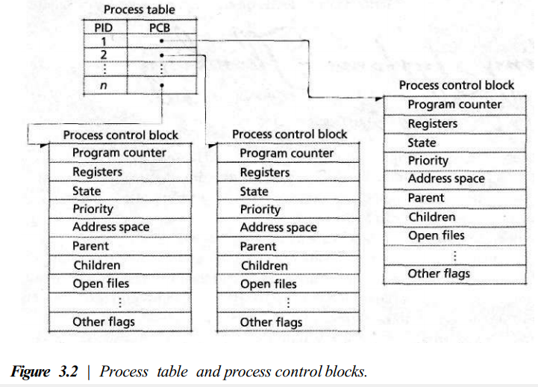
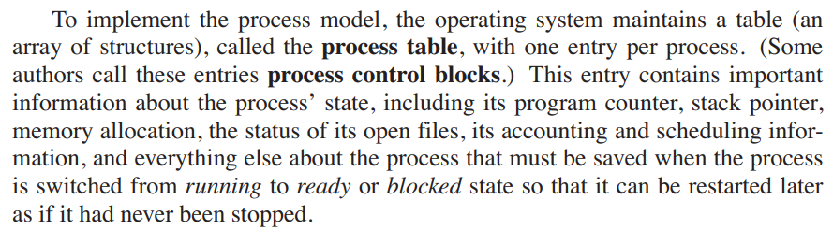
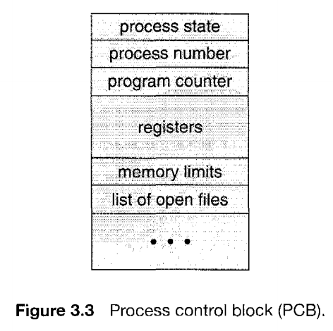
Process control block/ Process table

Slide 18
Components of PCB
A PCB is shown in . It contains many pieces of information associated with a specific process, including these :
Process state. The state may be new, ready, running, waiting, halted, and so on.
Program counter. The counter indicates the address of the next instruction to be executed for this process.
CPU registers. The registers vary in number and type, depending on the computer architecture. They include accumulators, index registers, stack pointers, and general-purpose registers, plus any condition-code information.
CPU-scheduling information. This information includes a process priority, pointers to scheduling queues, and any other scheduling parameters.
Accounting information. This information includes the amount of CPU and real time used, time limits, account numbers, job or process numbers, and so on.
I/O status information. This information includes the list of I/O devices allocated to the process, a list of open files, and so on.

Slide 19
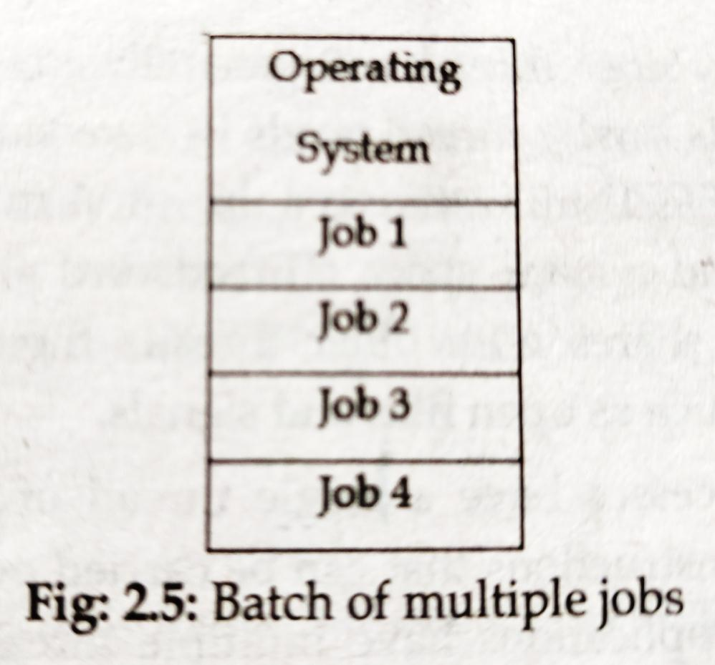
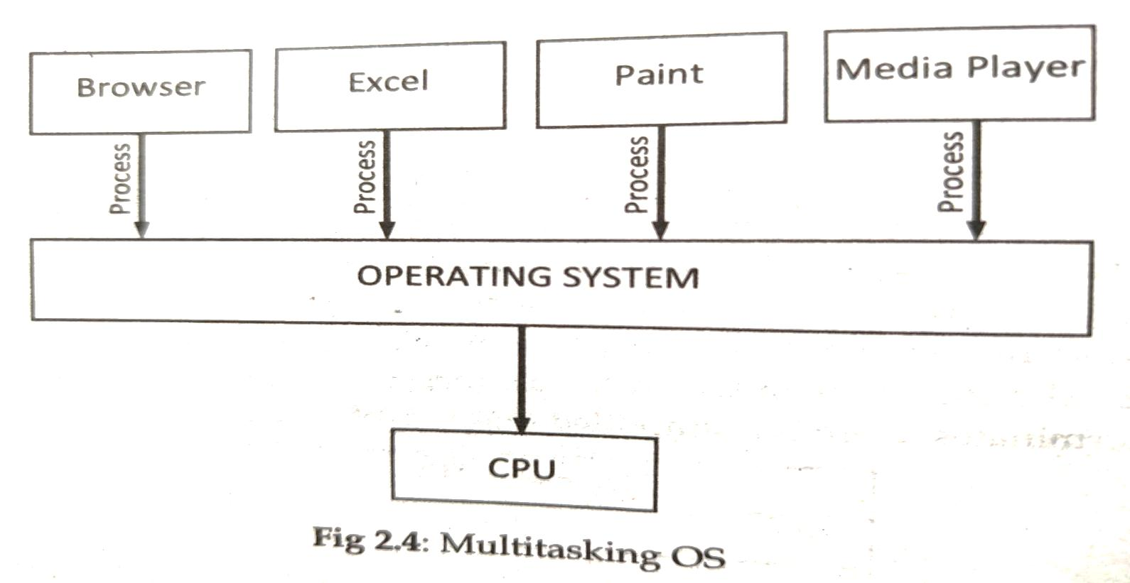
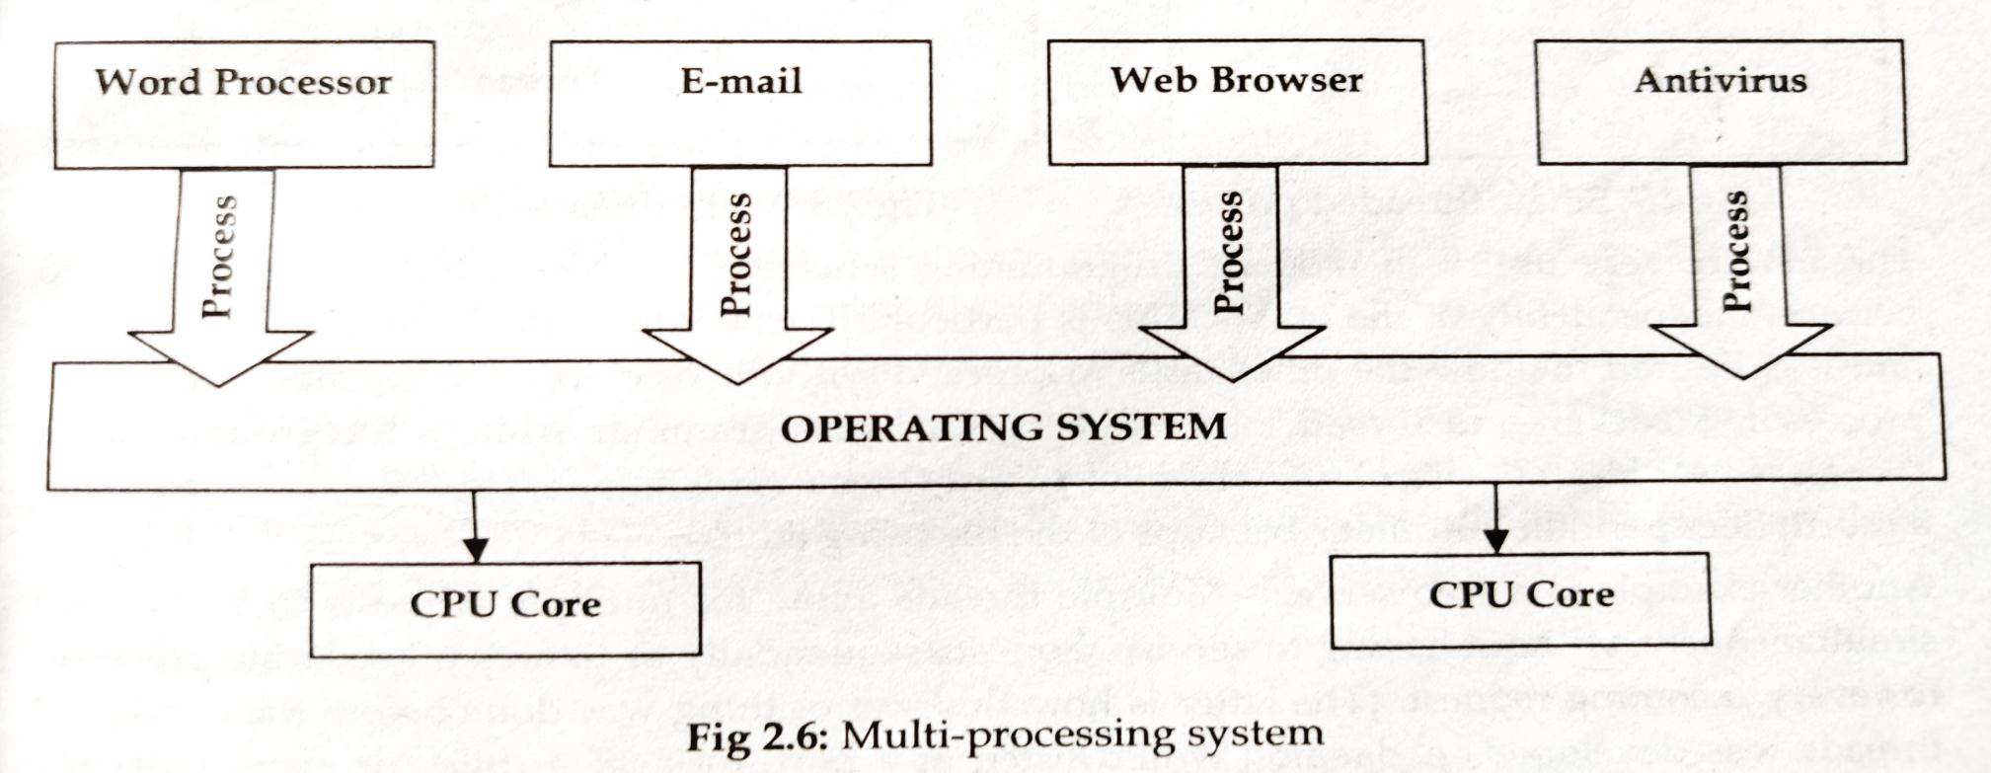

Slide 20
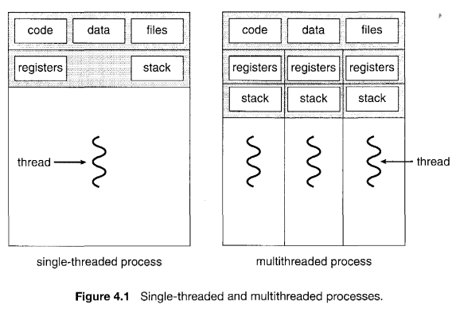
THREADS
A thread is a basic unit of CPU utilization; it comprises a thread ID, a program counter, a register set, and a stack. It shares with other threads belonging to the same process its code section, data section, and other operating-system resources, such as open files and signals. A traditional (or heavyweight) process has a single thread of control. If a process has multiple threads of control, it can perform more than one task at a time. Figure 4.1 illustrates the difference between a traditional single-threaded process and a multithreaded process.

Slide 21
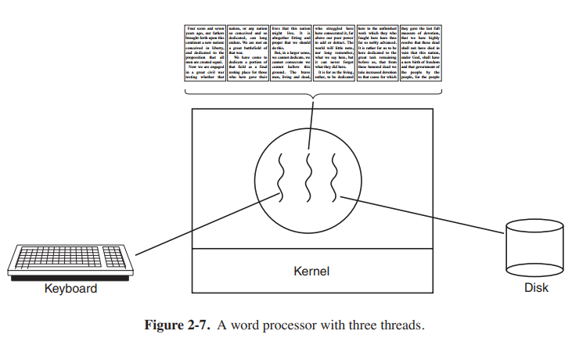
For example:
A word processor may have a thread for displaying graphics, another thread for responding to keystrokes from the user, and a third thread for performing spelling and grammar checking in the background.

Slide 22
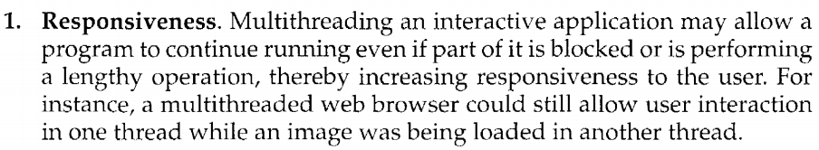
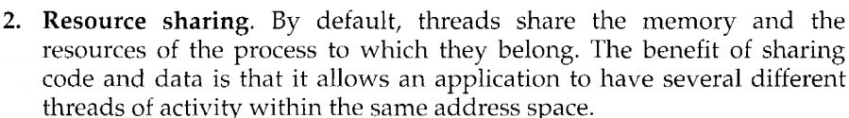
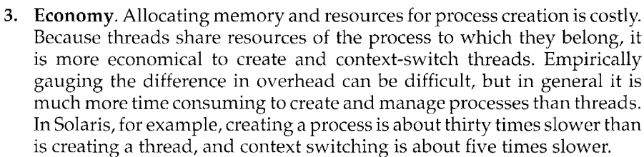
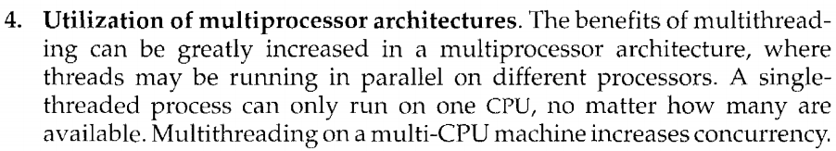
Benefits
The benefits of multithreaded programming can be broken down into four major categories:

Slide 23
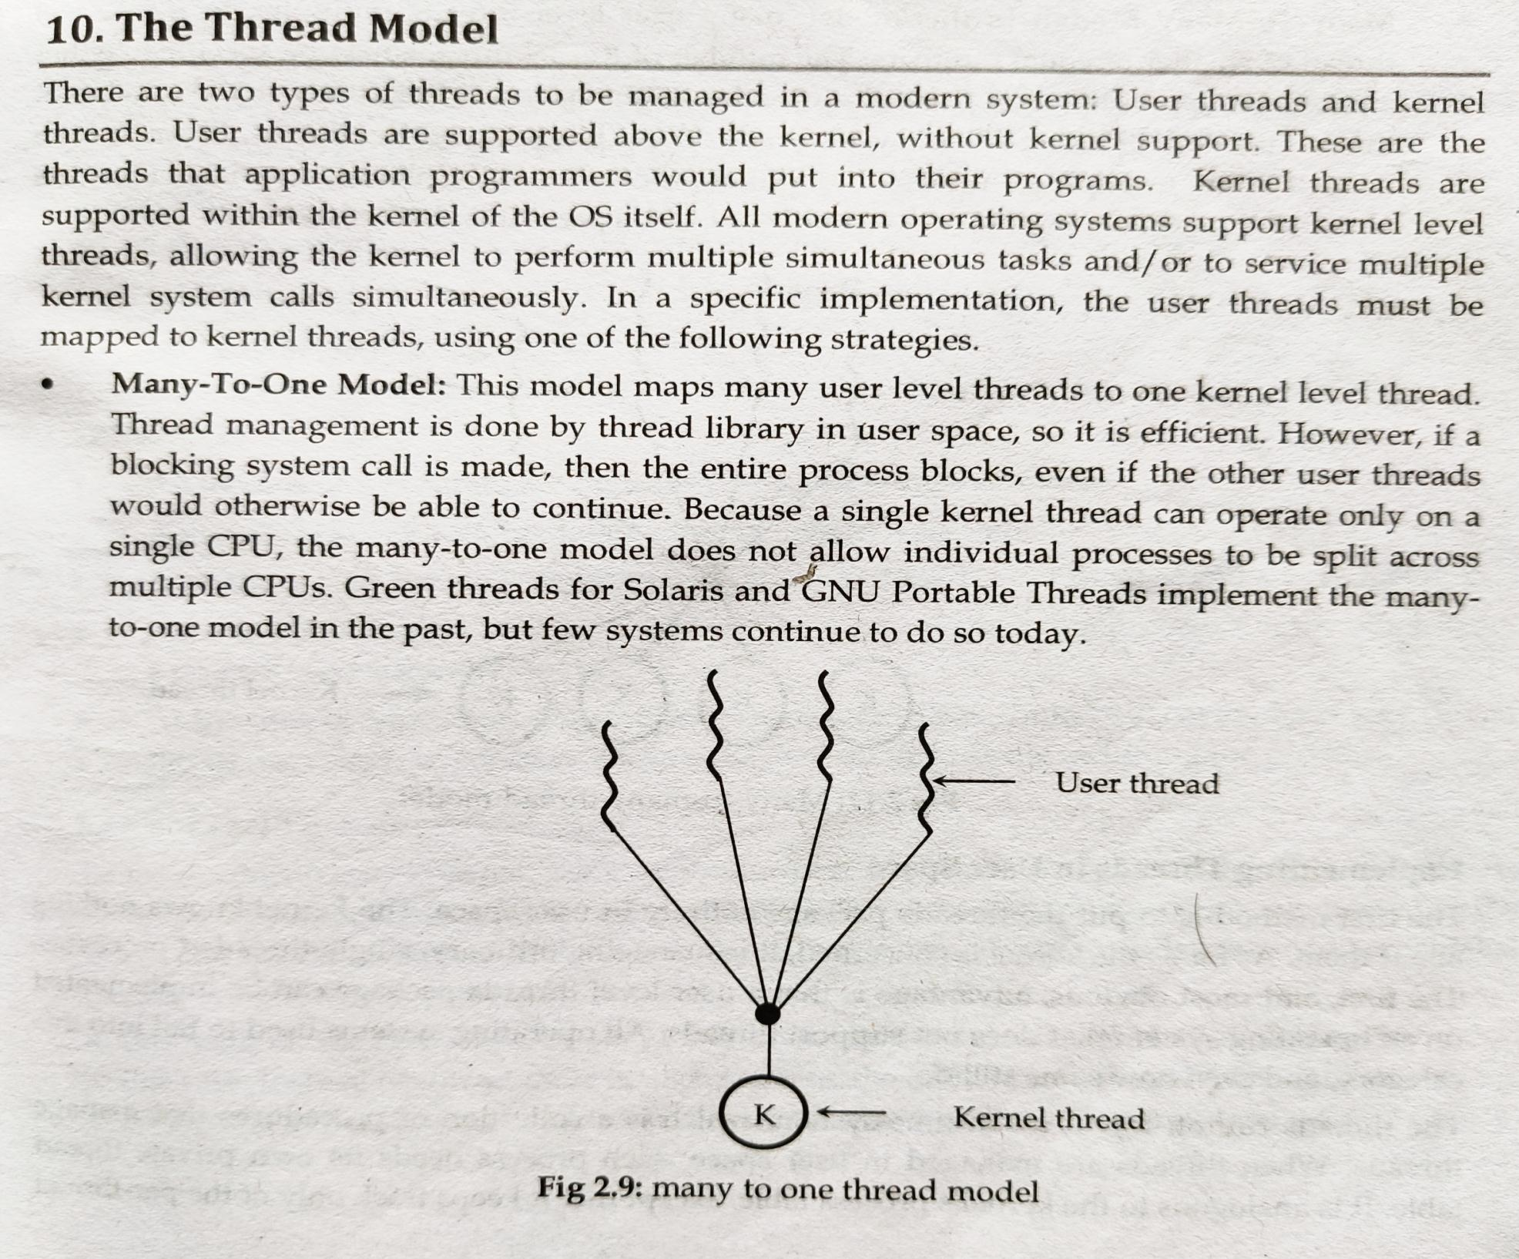

Slide 24
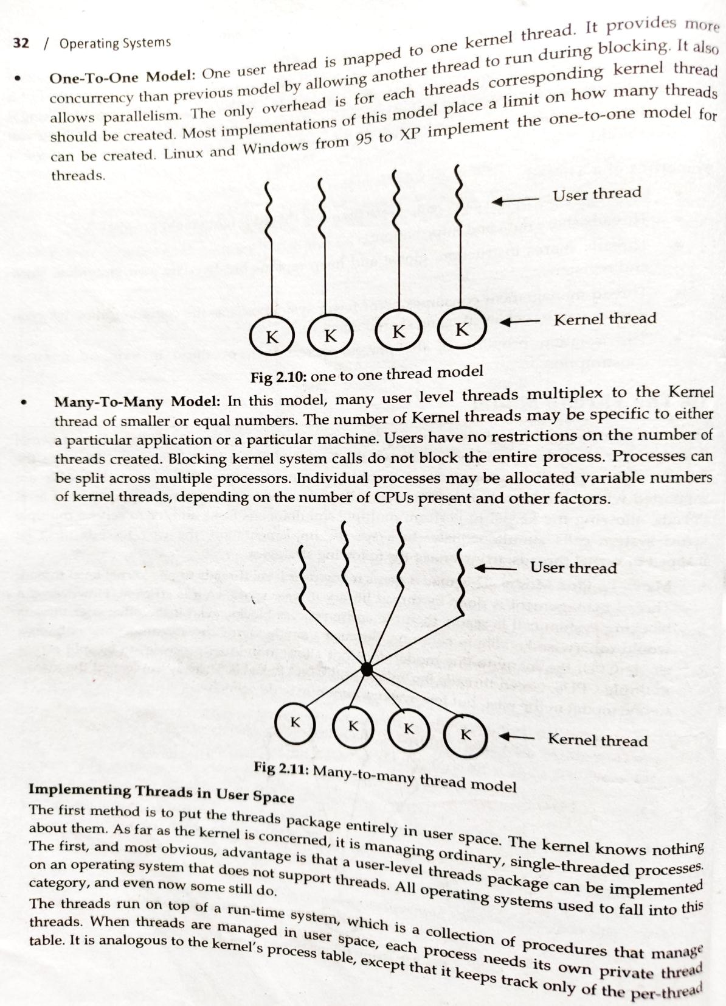

Slide 25
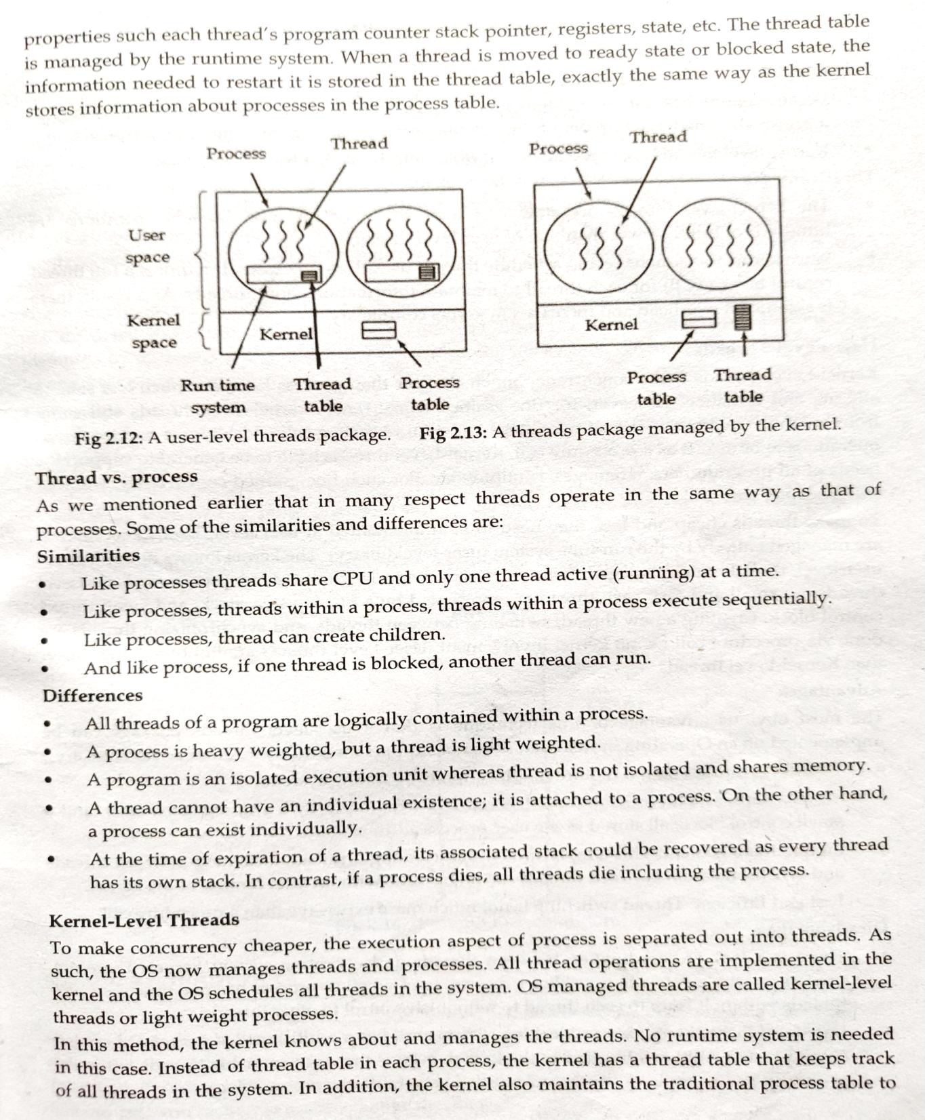

Slide 26
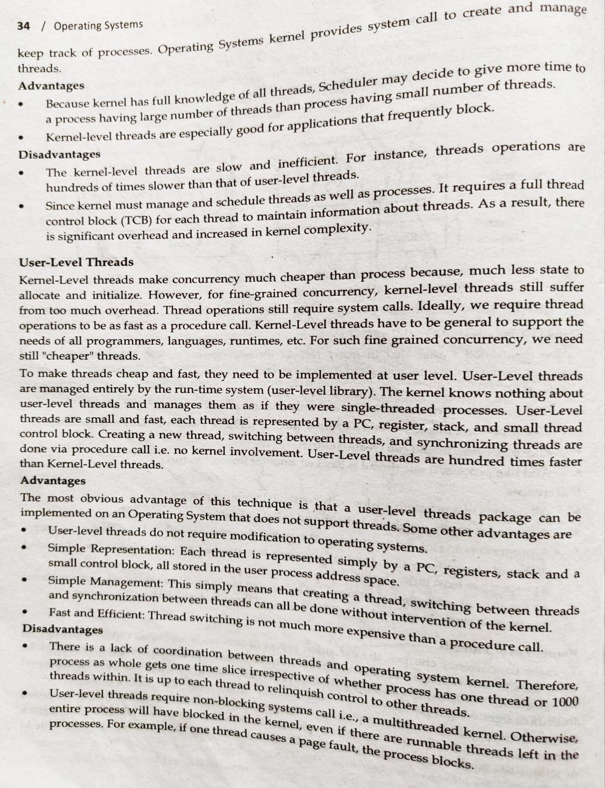

Slide 27
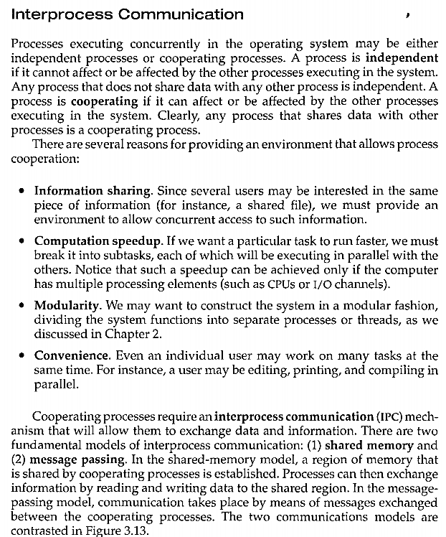

Slide 28
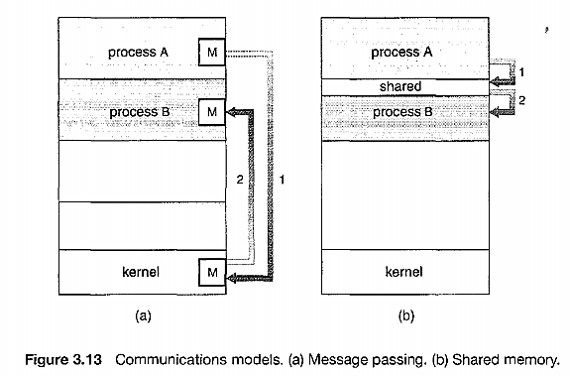

Slide 29
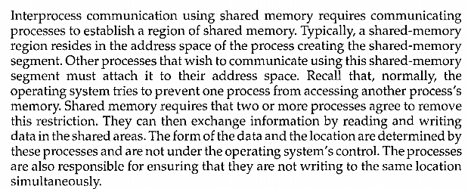
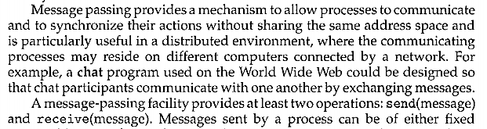

Slide 30
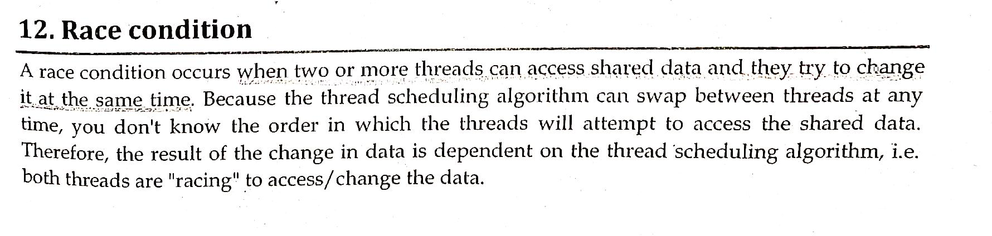
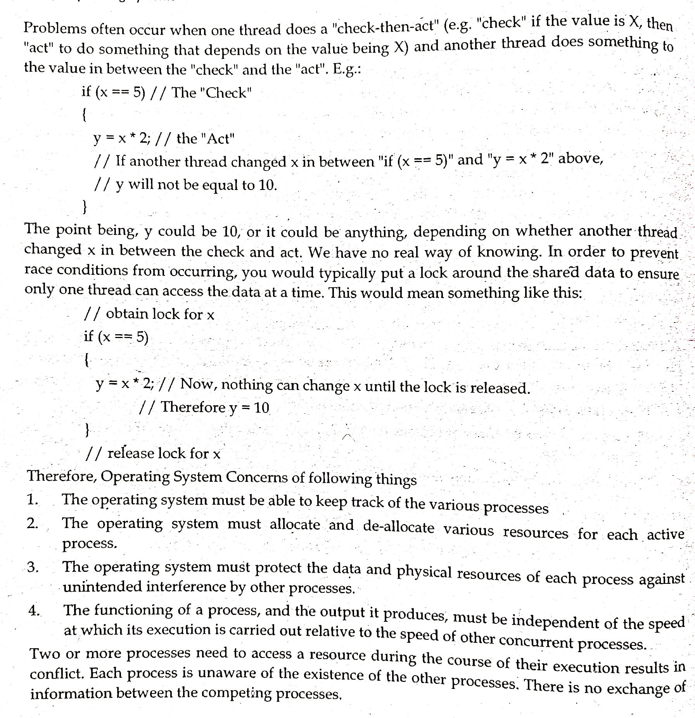

Slide 32
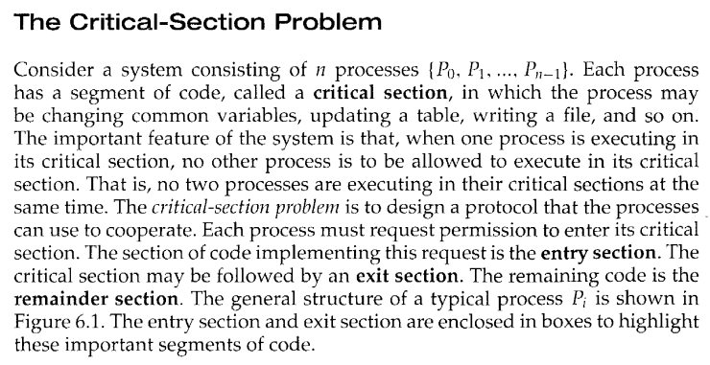
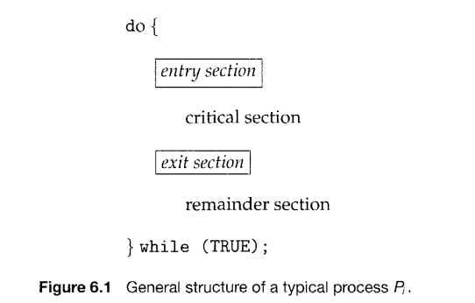

Slide 33
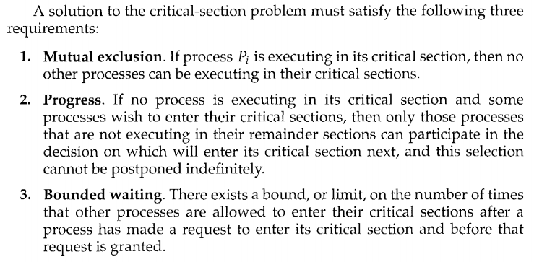

Slide 34
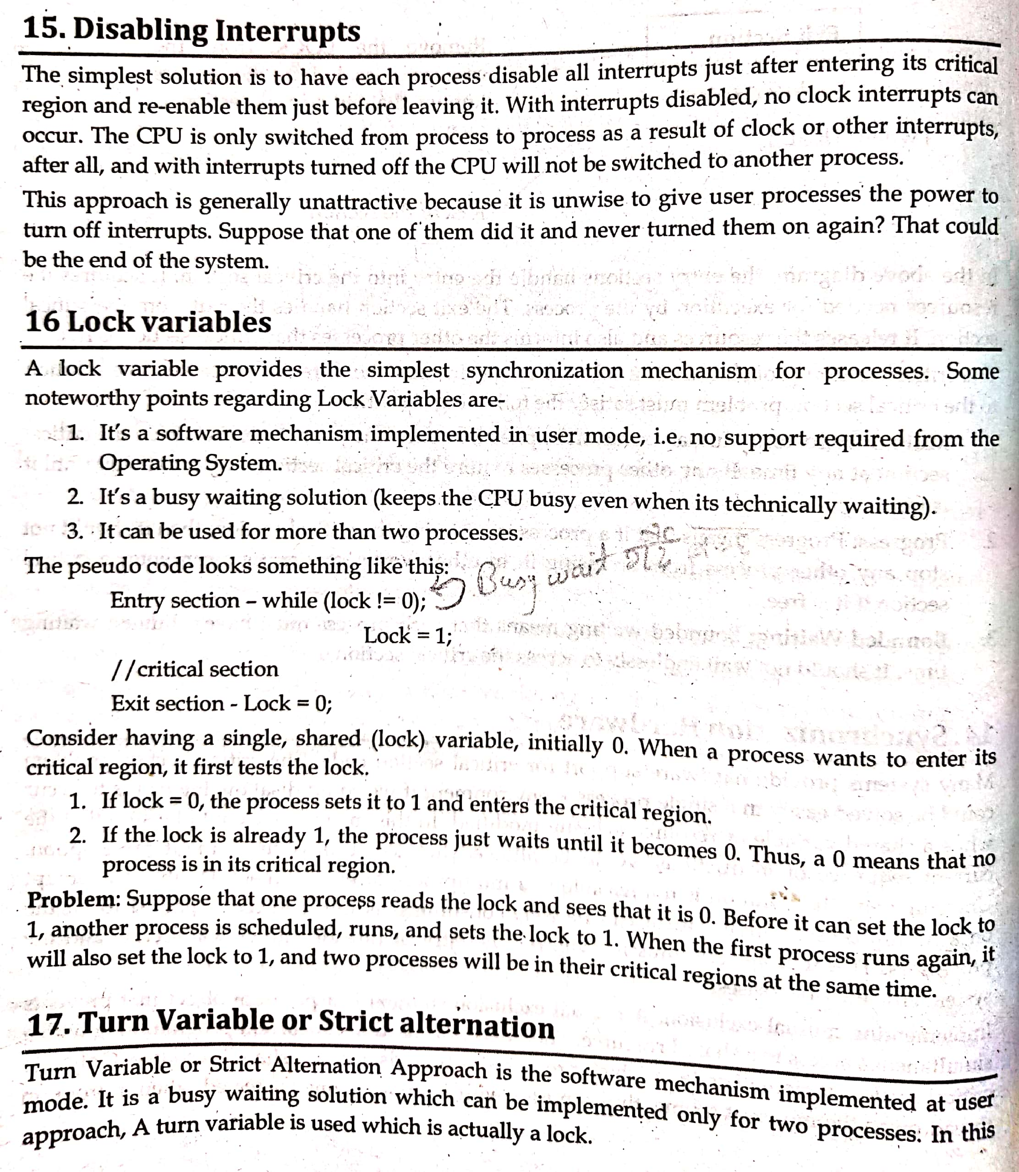
Implementing Mutual Exclusion

Slide 35
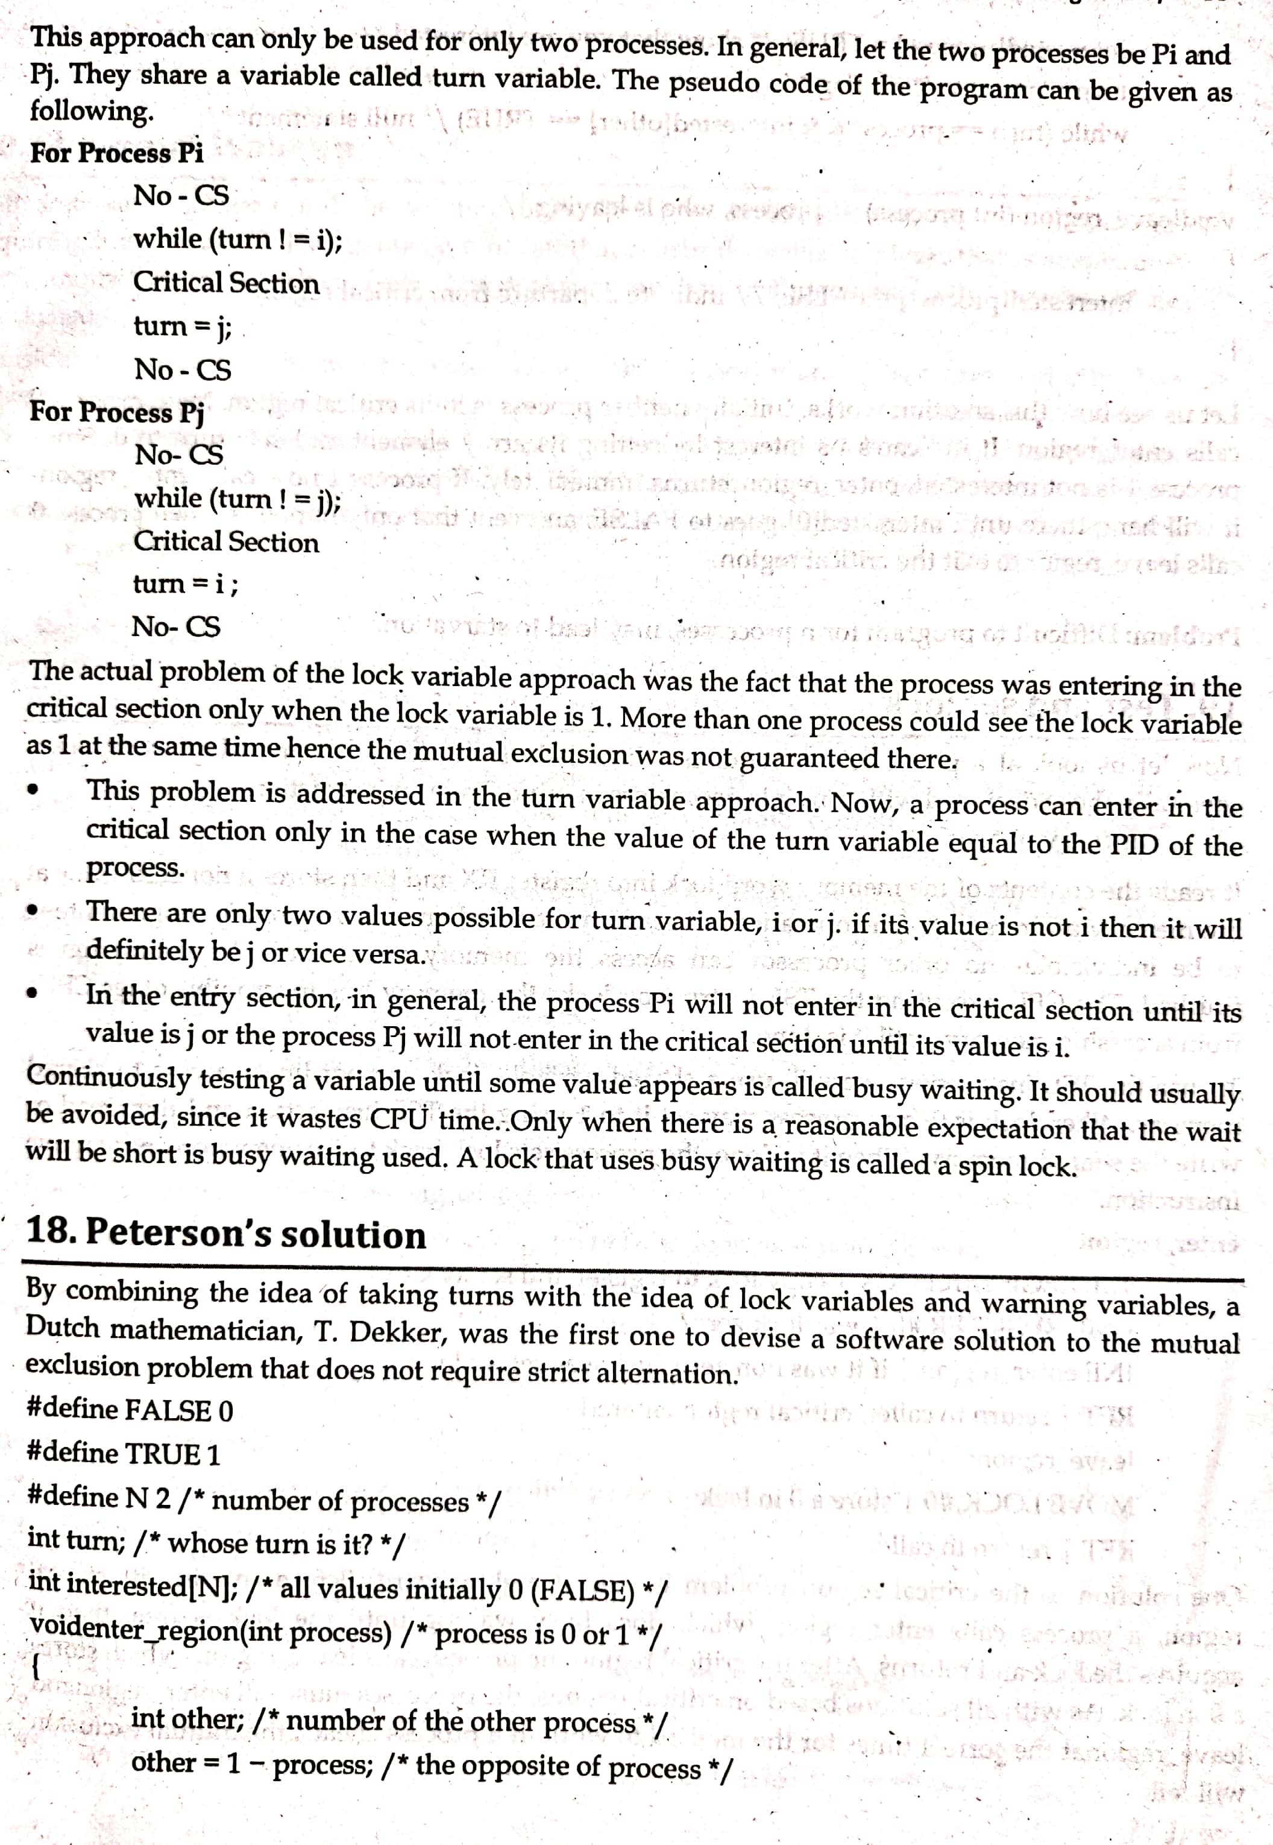
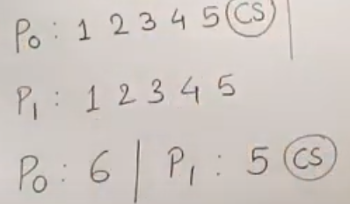
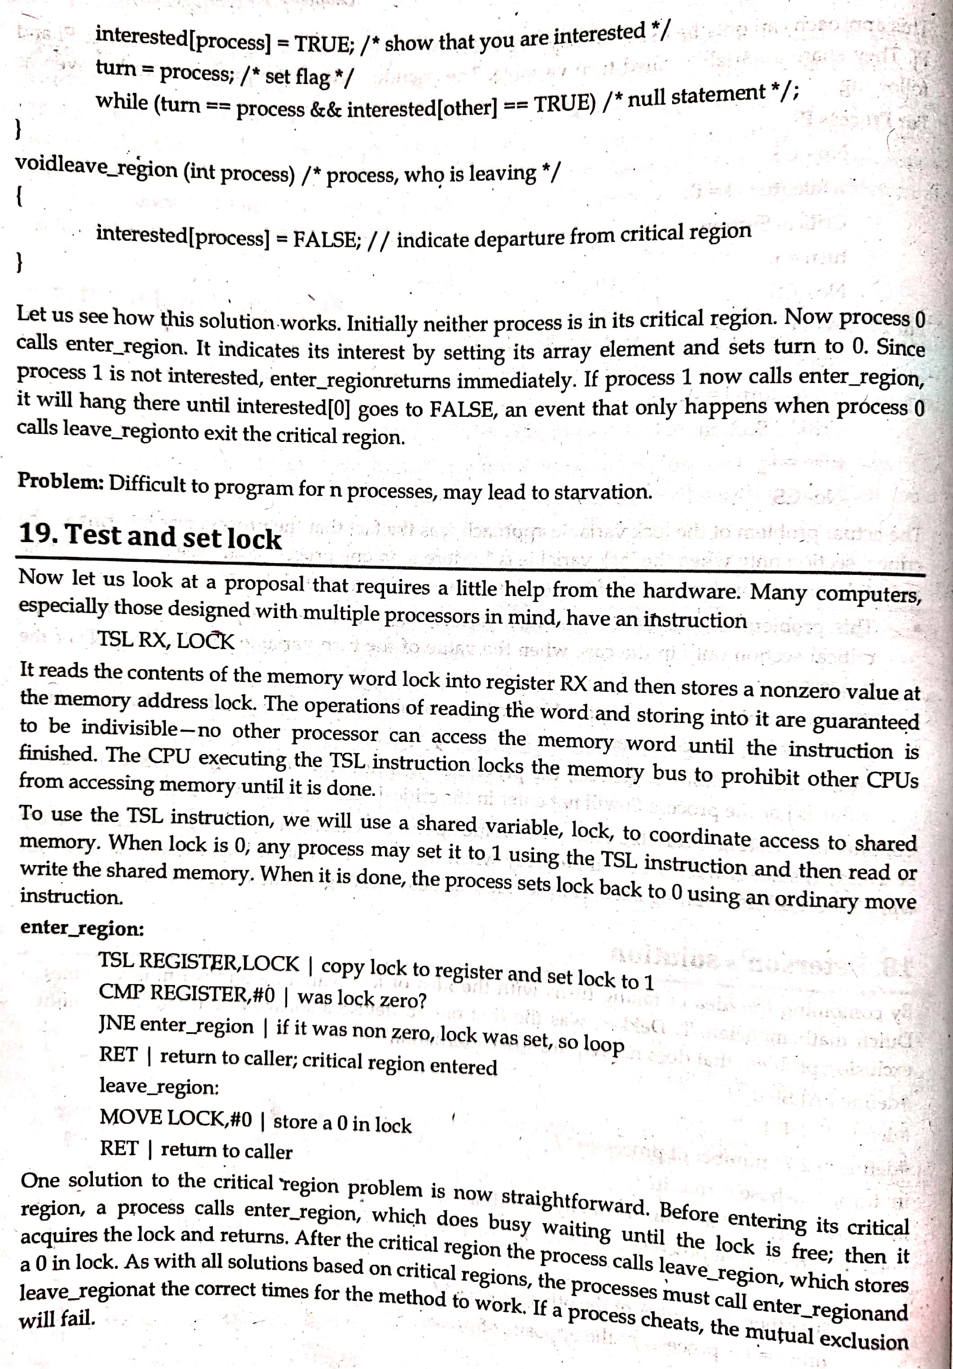
CS

Slide 36
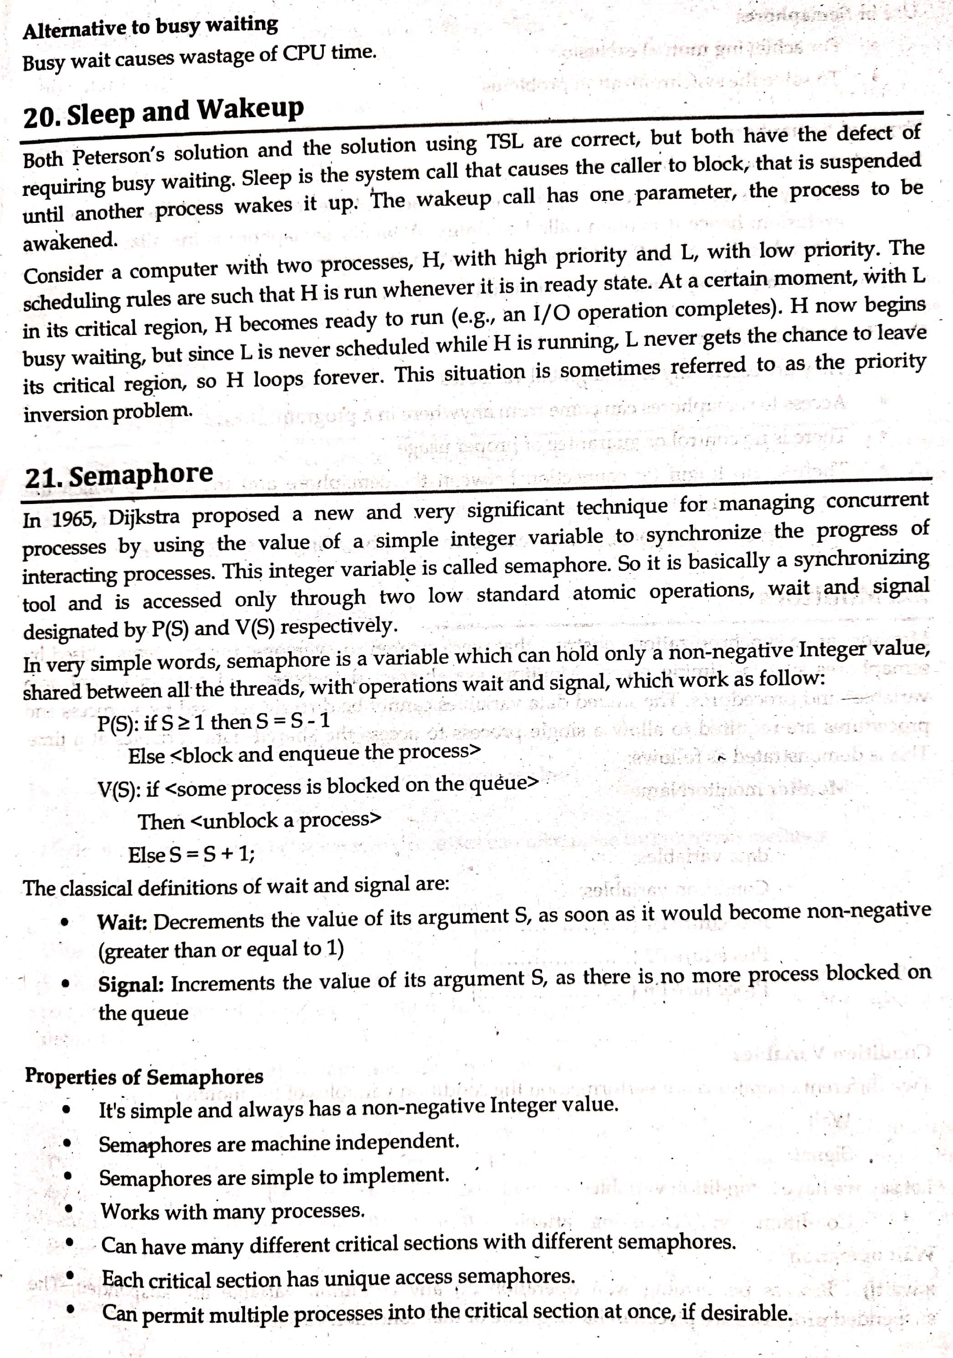

Slide 37
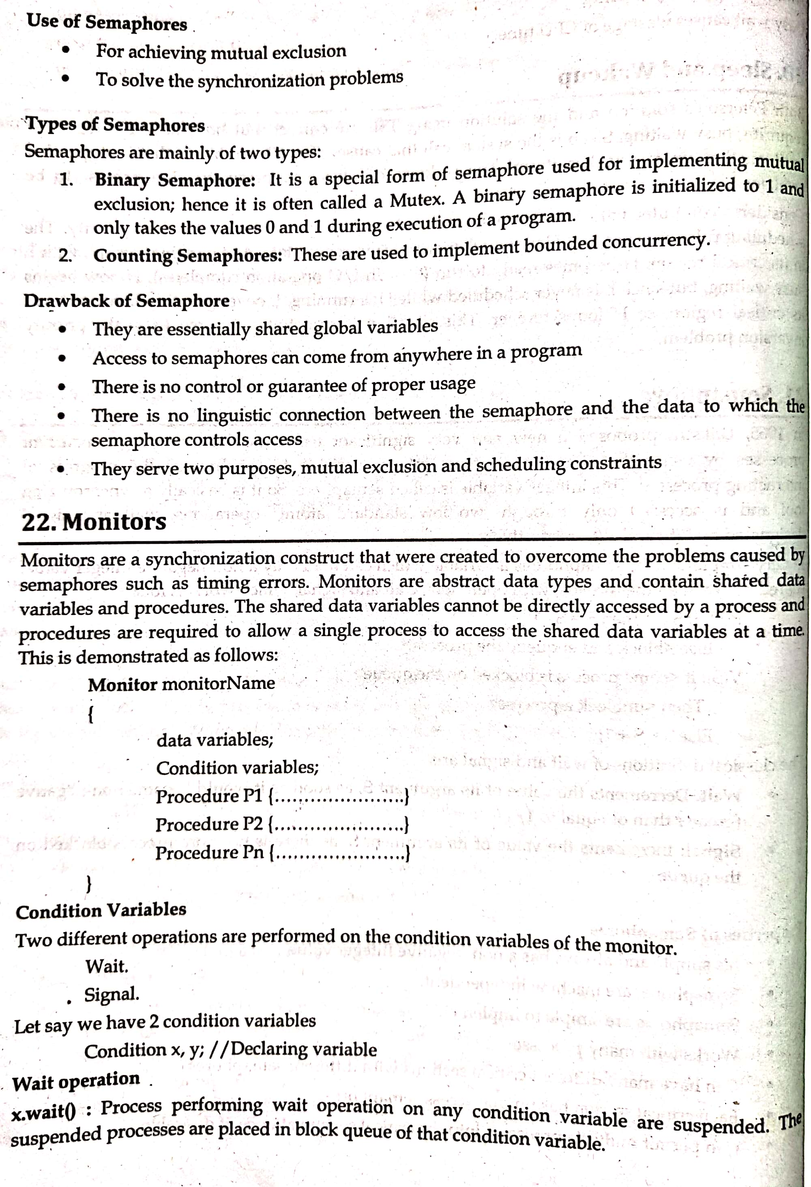
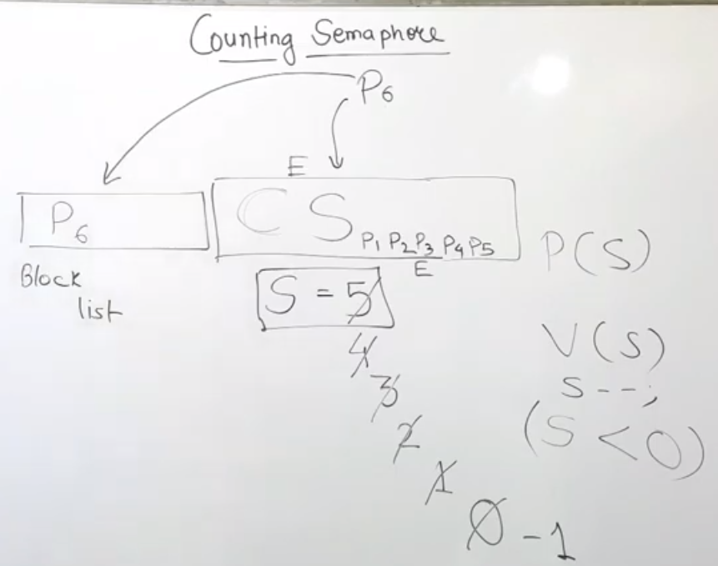
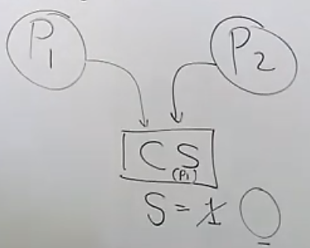
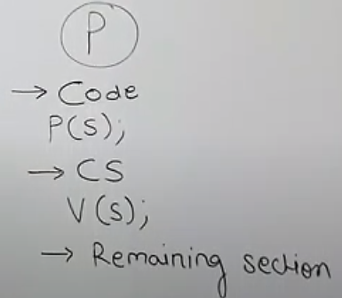

Slide 38
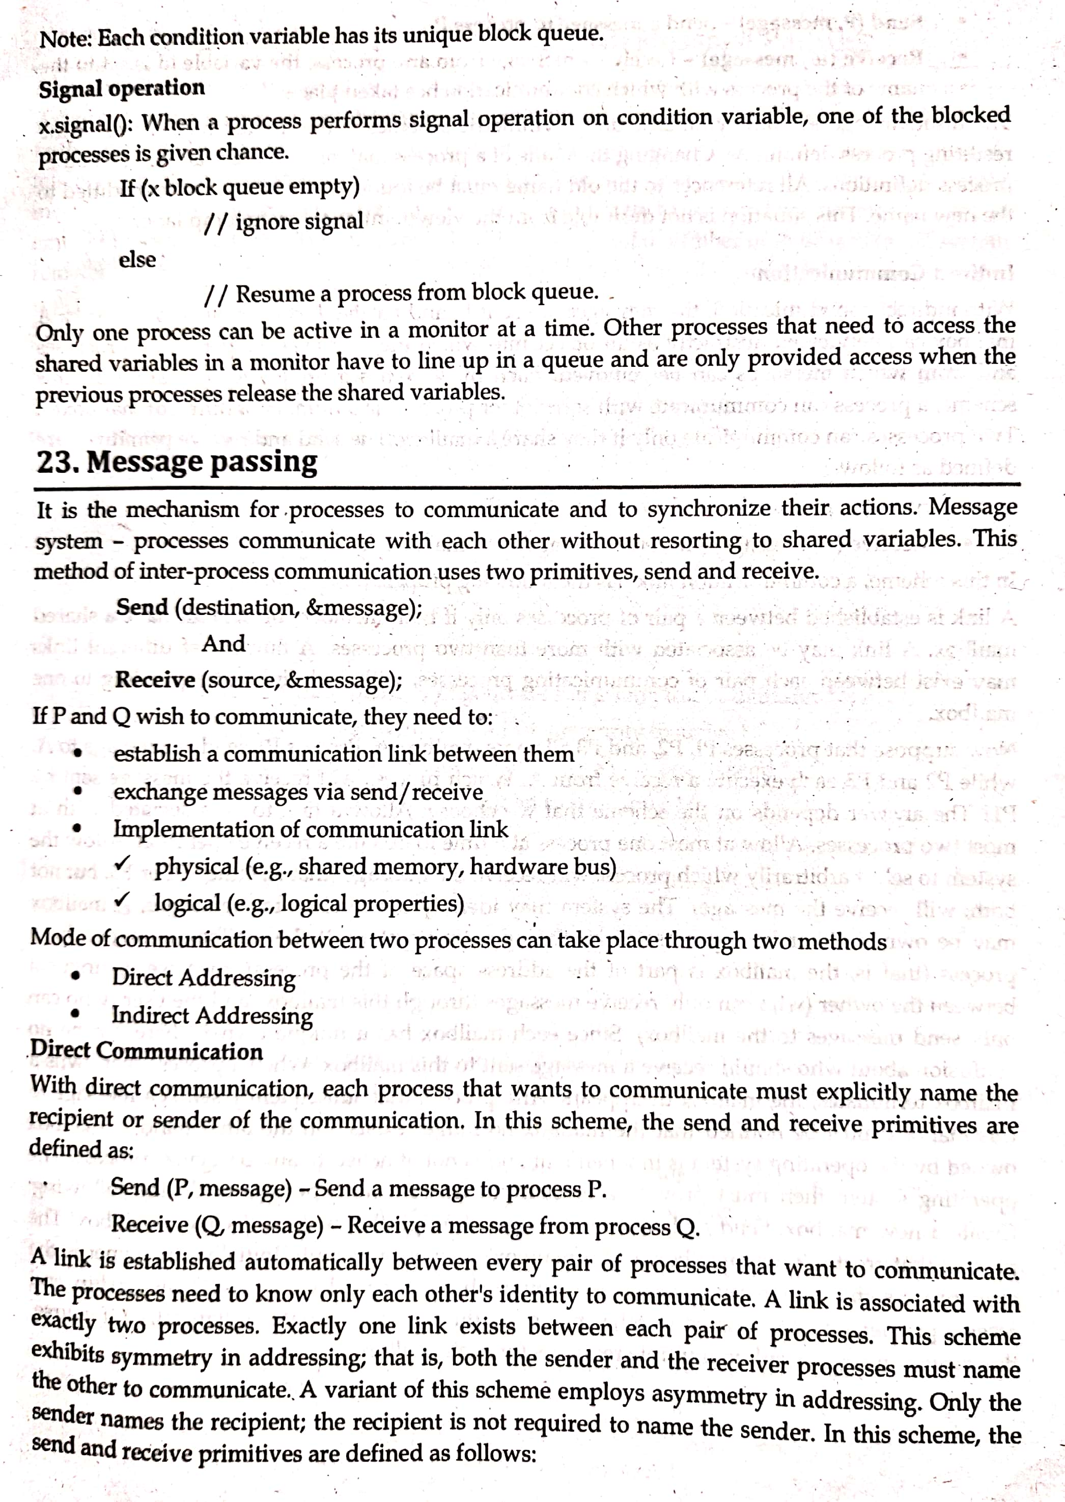

Slide 39
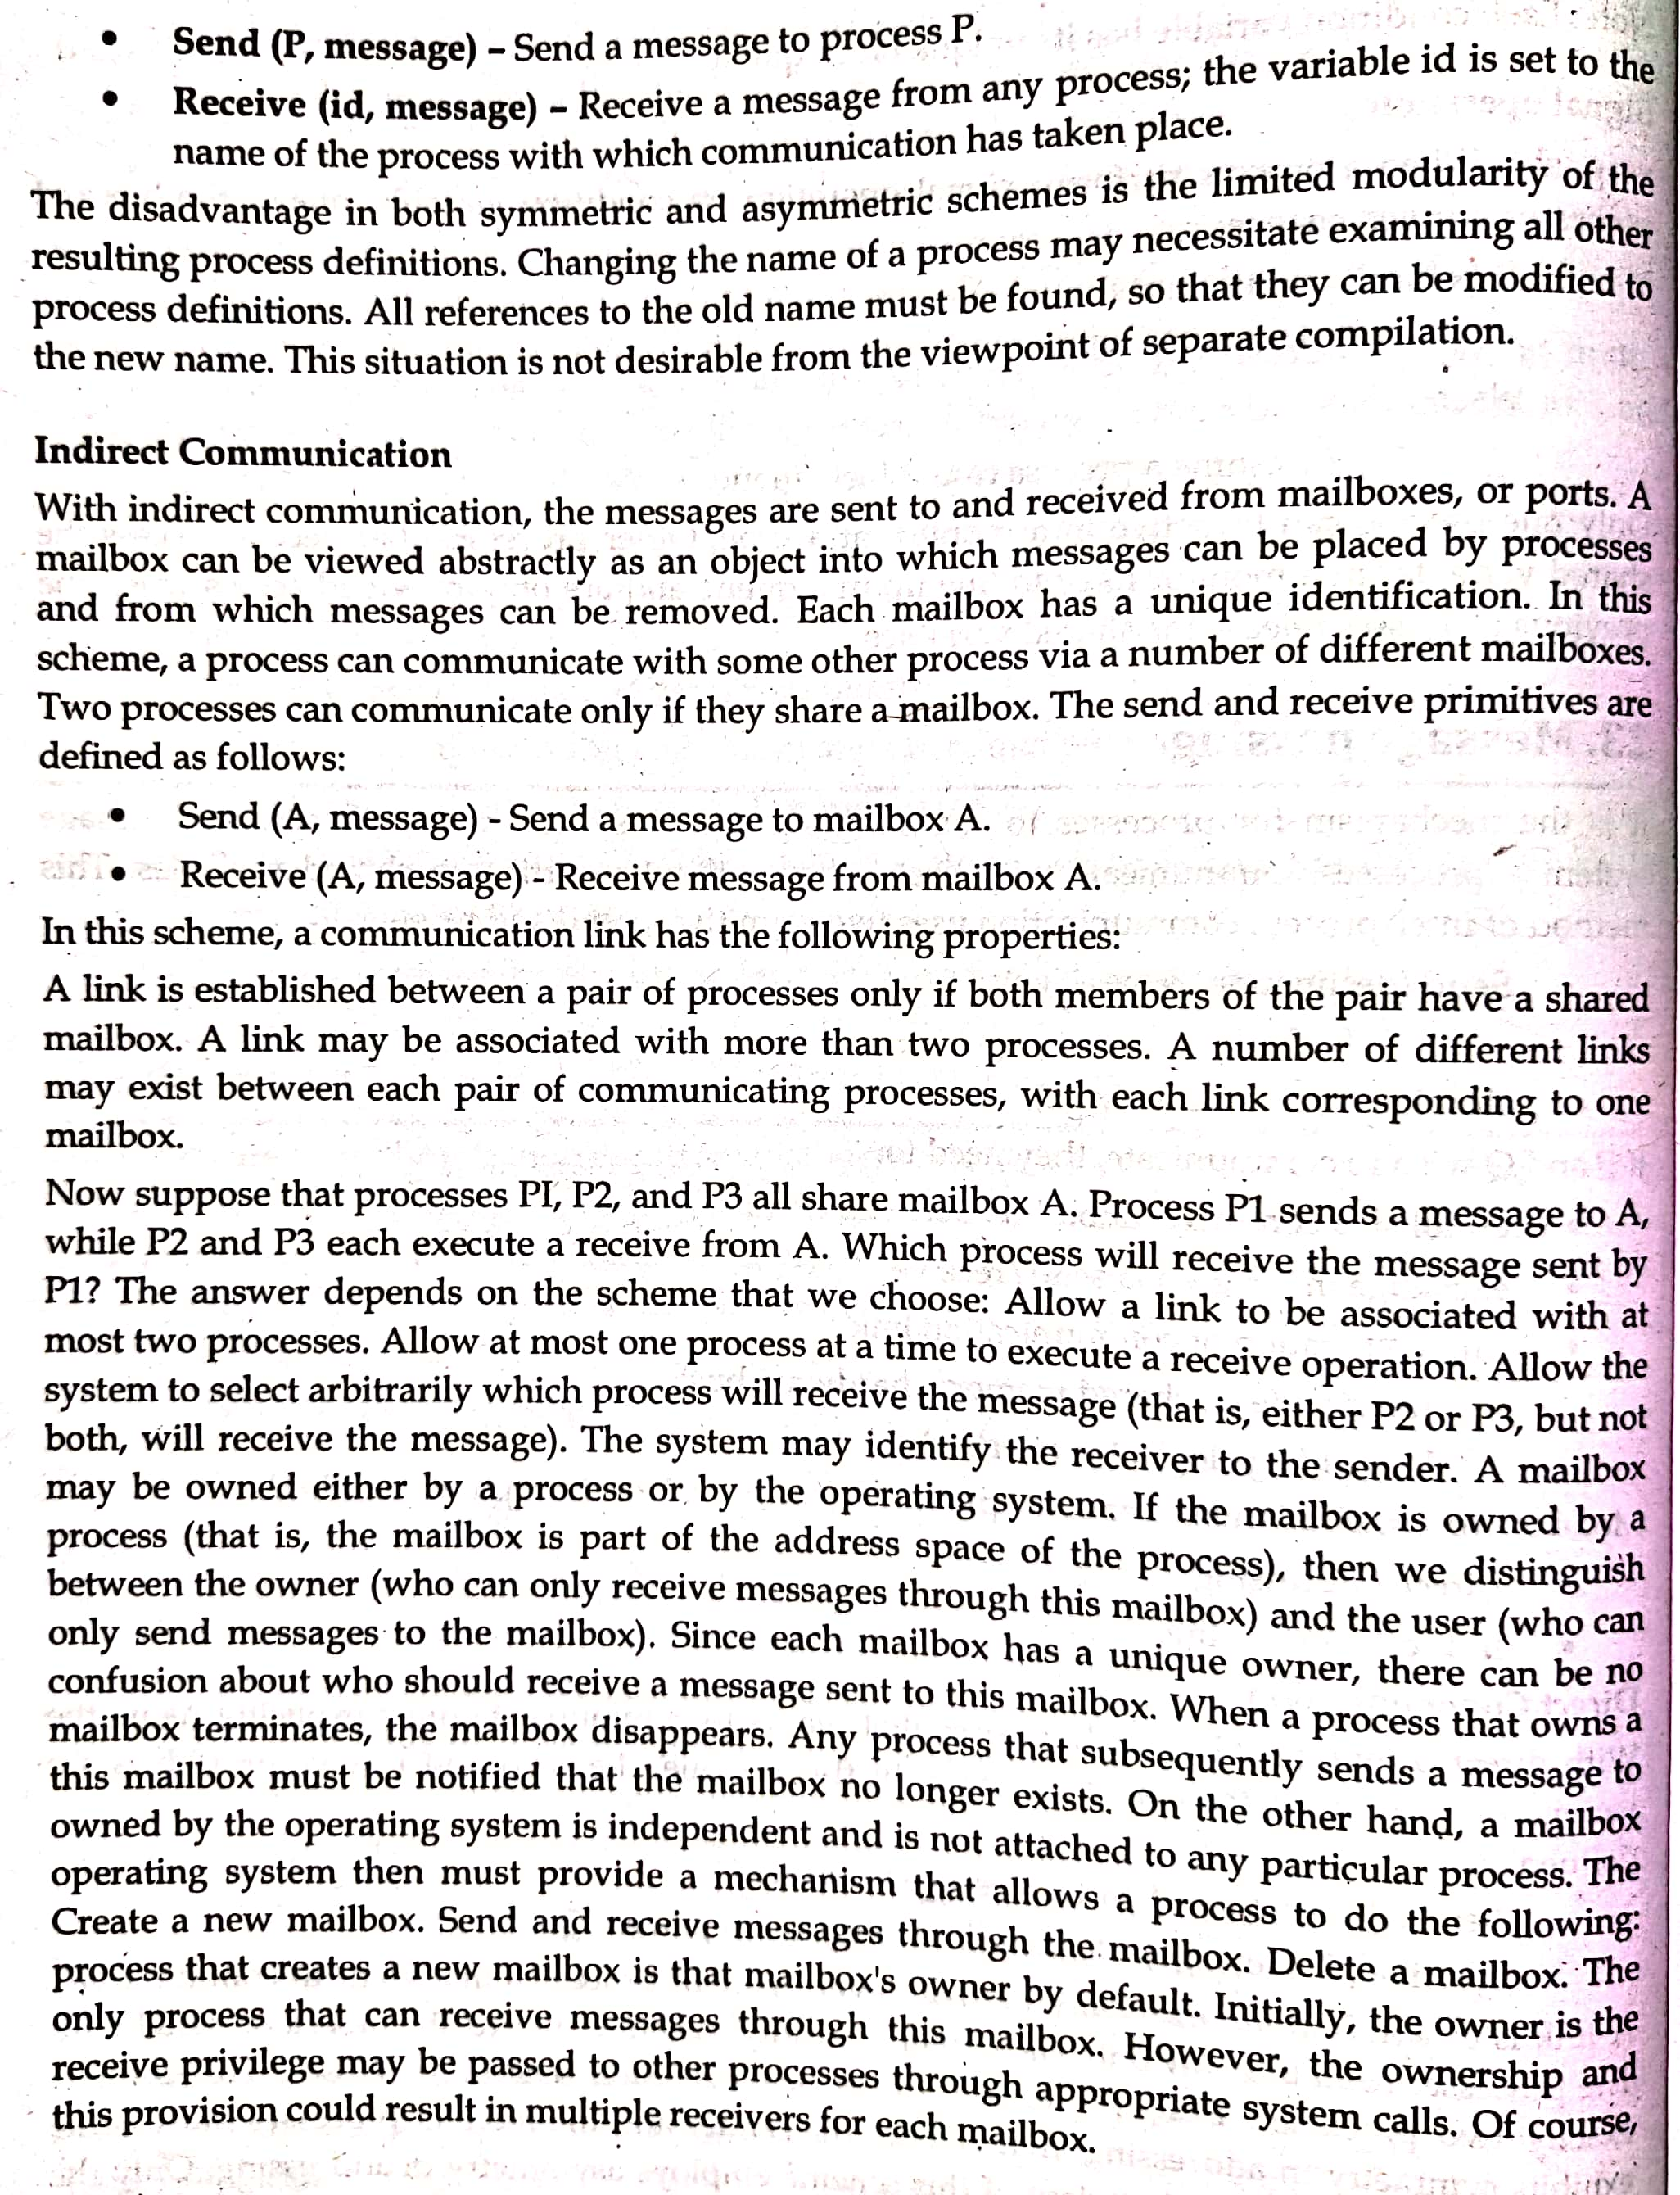

Slide 41
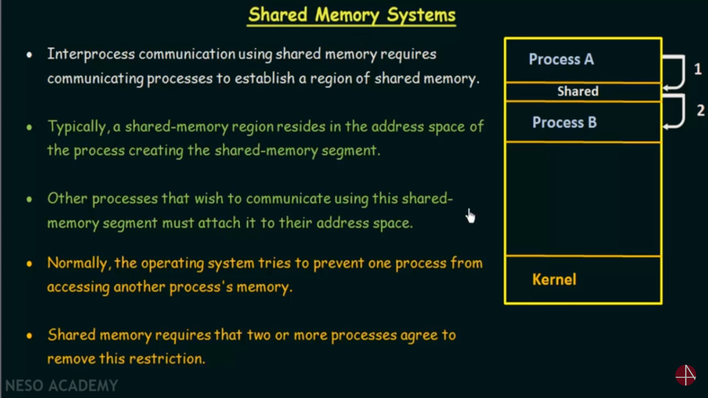

Slide 42
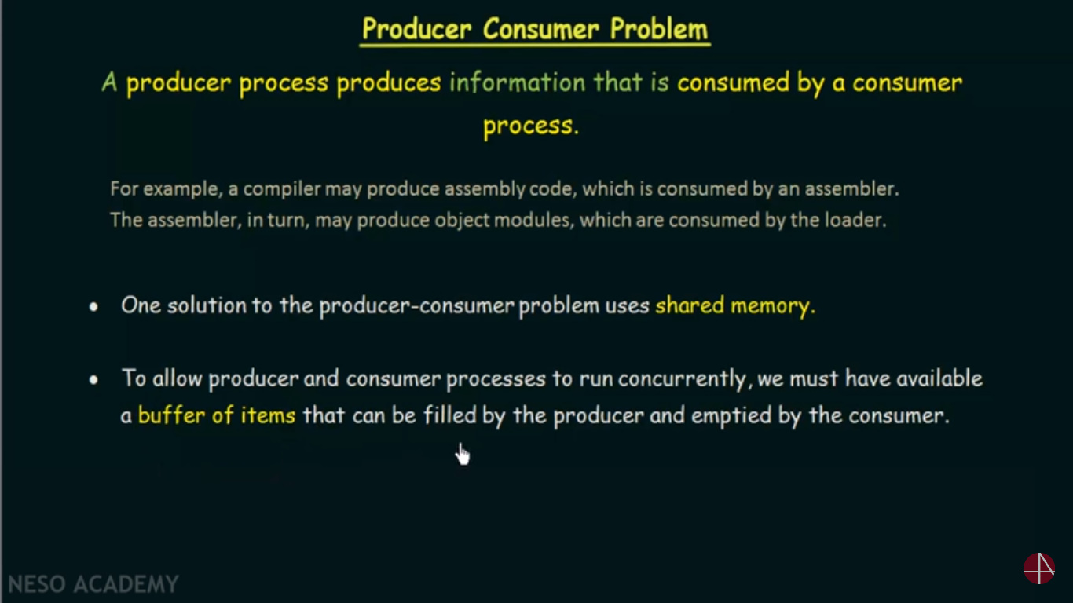
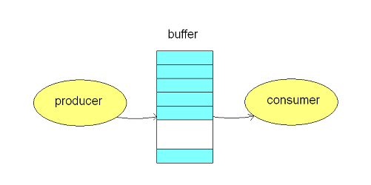

Slide 43
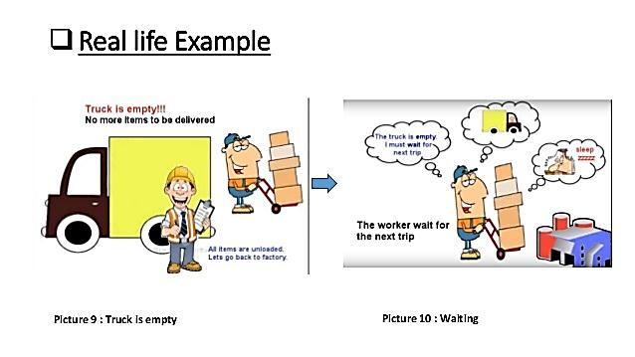

Slide 44
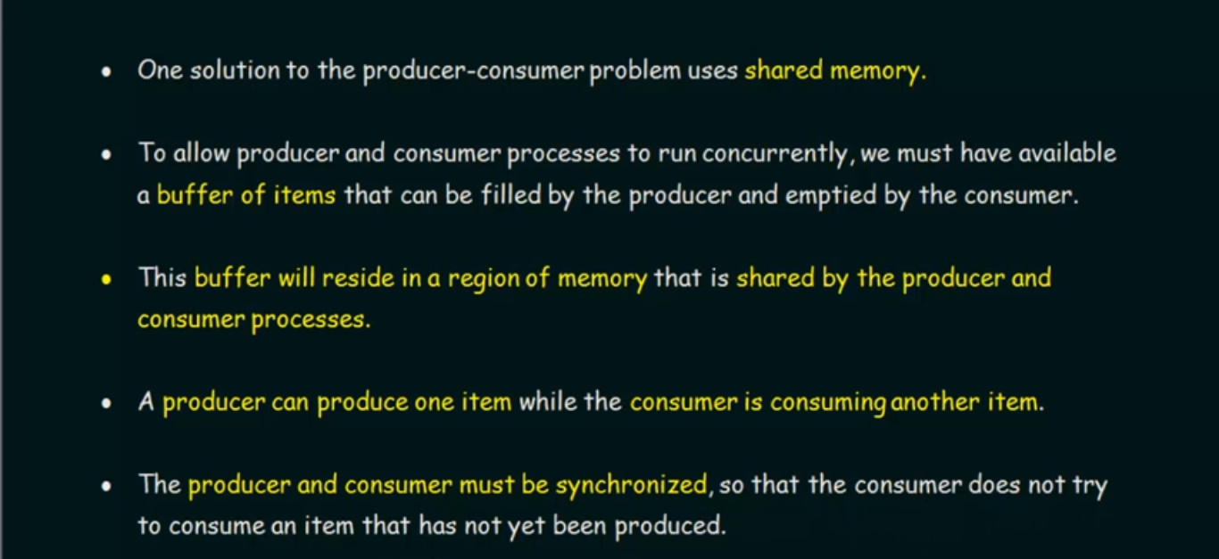

Slide 45
